Slide 1
Samples structure and characterization
MoS₂
Top contact / Bottom gate
Note: If you need, you can scratch the surface of the substrates to access the gate.
Au/Cr 45/3 nm
BCB layer 50 nm
SiO_{x} 278 nm
MEASUREMENTS
n-type semiconductor
Low stability in aire, storage in glove box
Electrical measurements were performed reaching V_{DS} = 1 V, and V_{GS} = -60 to 60 V
Delay 100 ms and ΔV_{GS} = 0.5 V
Si

Slide 2
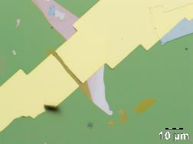
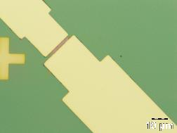
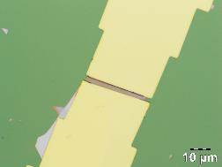
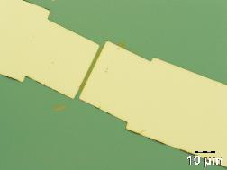
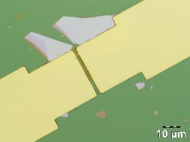
Thickness Channel Size
Device 1 = 4.5±0.5 nm L= 2.6 W= 19.8
Device 2 = 5.4±0.7 nm L= 2.3 W= 11.6
Device 3 = 6.0±0.6 nm L= 2.7 W= 21.2
Device 4 = 2.6±0.3 nm L= 2.3 W= 17.6
Device 5 = 2.9±0.7 nm L= 2.7 W= 14.1
Sample 1
Device 1
Device 2
Device 3
Device 4
Device 3
Device 4
Device 1
Device 2
Device 5
Device 5

Slide 3
Thickness Channel Size
Device 1 = 4.5±0.5 nm L= 2.6 W= 19.8
Device 2 = 5.4±0.7 nm L= 2.3 W= 11.6
Device 3 = 6.0±0.6 nm L= 2.7 W= 21.2
Device 4 = 2.6±0.3 nm L= 2.3 W= 17.6
Device 5 = 2.9±0.7 nm L= 2.7 W= 14.1
Sample 1
Device 1
Device 2
Device 3
Device 4
Device 3
Device 4
Device 1
Device 2
Device 5
Device 5

Slide 4
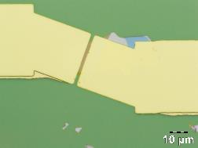
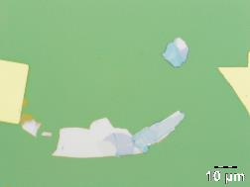
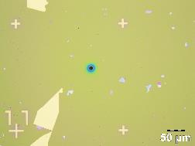
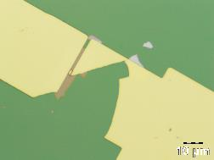
Thickness
Device 1 = 2.4±0.3 nm L= 2.3 W= 13.6
Device 2 = -
Device 3 = -
Device 4 = -
Sample 4
Device 1
Device 2
Device 3
Device 4
Device 4
Device 3
Device 2
Device 1

Slide 5
Thickness
Device 1 = 2.4±0.3 nm L= 2.3 W= 13.6
Device 2 = -
Device 3 = -
Device 4 = -
Sample 4
Device 4
Device 3
Device 2
Device 1

Slide 6
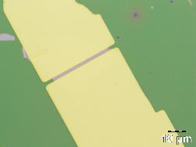
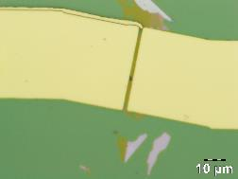
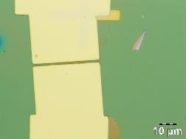
Thickness
Device 1 = 8.9±0.9 nm L= 2.3 W= 21.8
Device 2 = 5.8±0.9 nm L= 2.2 W= 20.9
Device 3 = 2.8±0.4 nm L= 2.0 W= 16.4
Device 4 = 3.1±0.5 nm
Sample 5
Device 1
Device 2
Device 1
Device 3
Device 4
Device 2
Device 4
Device 3

Slide 7
Thickness
Device 1 = 8.9±0.9 nm L= 2.3 W= 21.8
Device 2 = 5.8±0.9 nm L= 2.2 W= 20.9
Device 3 = 2.8±0.4 nm L= 2.0 W= 16.4
Device 4 = 3.1±0.5 nm
Sample 5
Device 2
Device 1
Device 1
Device 3
Device 4
Device 2
Device 4
Device 3

Slide 8
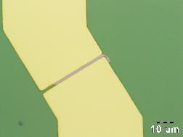
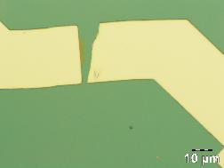
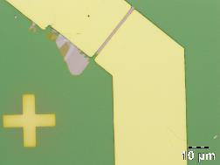
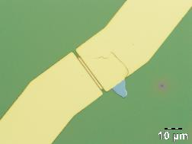
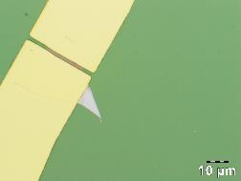
Thickness
Device 1 = 8.3±0.9 nm L = 2.3 W= 24.5
Device 2 = -
Device 3 = 10.8±0.6 nm L = 2.1 W= 21.1
Device 4 = -
Device 5 = 6.3±0.6 nm L = 2.1 W= 14.7
Sample 6
Device 1
Device 2
Device 3
Device 4
Device 3
Device 4
Device 1
Device 2
Device 5
Device 5

Slide 9
Thickness
Device 1 = 8.3±0.9 nm L = 2.3 W= 24.5
Device 2 = -
Device 3 = 10.8±0.6 nm L = 2.1 W= 21.1
Device 4 = -
Device 5 = 6.3±0.6 nm L = 2.1 W= 14.7
Sample 6
Device 1
Device 3
Device 5
Device 3
Device 4
Device 1
Device 2
Device 5

Slide 10
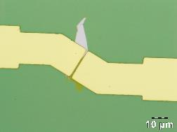
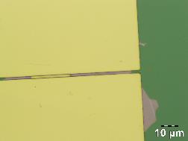
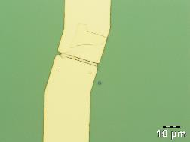
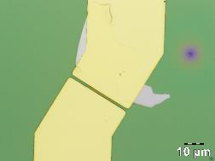
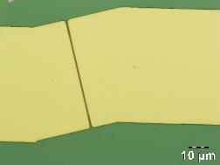
Thickness
Device 1 = 2.8±0.4 nm L=1.9 W=10.0
Device 2 = -
Device 3 = -
Device 4 = 3.8±0.4 nm L=2.2 W=13.8
Device 5 = 5.7±0.3 nm L= 1.3 W=32.1
Sample 7
Device 1
Device 2
Device 3
Device 4
Device 4
Device 3
Device 5
Device 1
Device 2
Device 5

Slide 11
Thickness
Device 1 = 2.8±0.4 nm L=1.9 W=10.0
Device 2 = -
Device 3 = -
Device 4 = 3.8±0.4 nm L=2.2 W=13.8
Device 5 = 5.7±0.3 nm L= 1.3 W=32.1
Sample 7
Device 1
Device 4
Device 5
Device 4
Device 3
Device 1
Device 2
Device 5

Slide 12
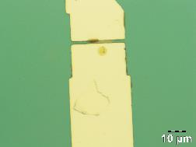
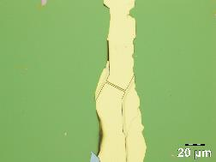
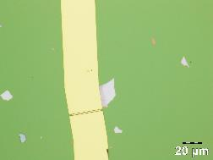
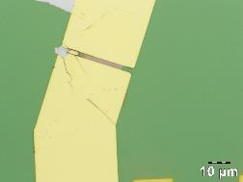
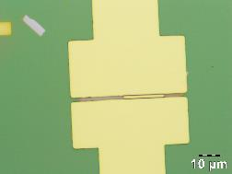
Thickness
Device 1 = 6.2±0.6 nm L= 2.0 W= 8.2
Device 2 = -
Device 3 = -
Device 4 = -
Device 5 = -
Sample 8
Device 1
Device 2
Device 3
Device 4
Device 5
Device 2
Device 4
Device 1
Device 5
Device 3
Device 6

Slide 13
Thickness
Device 1 = 6.2±0.6 nm L= 2.0 W= 8.2
Device 2 = -
Device 3 = -
Device 4 = -
Device 5 = -
Sample 8
Device 1
Device 4
Device 3
Device 1
Device 2
Device 5

Slide 14
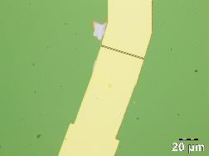
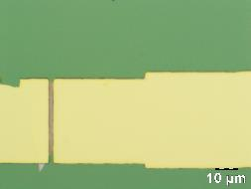
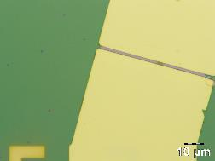
Thickness
Device 1 = -
Device 2 = 7.8±0.7 nm L= 2.4 W= 20.6
Device 3 = 10.8±1.4 nm L= 2.2 W= 39.6
Sample 9
Device 1
Device 2
Device 3
Device 3
Device 1
Device 2

Slide 15
Thickness
Device 1 = -
Device 2 = 7.8±0.7 nm L= 2.4 W= 20.6
Device 3 = 10.8±1.4 nm L= 2.2 W= 39.6
Sample 9
Device 2
Device 3
Device 3
Device 1
Device 2

Slide 16
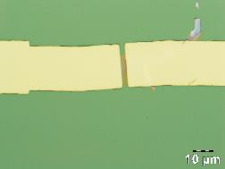
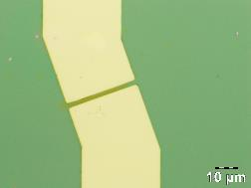
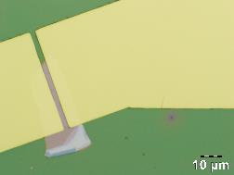
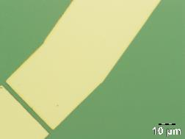
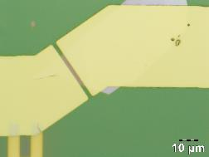
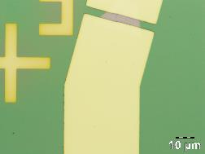
Thickness
Device 1 = 3.9±0.5 nm L= 3.0 W= 12.4
Device 2 = 2.6±0.3 nm L= 2.6 W= 16.6
Device 3 = 8.7±0.4 nm L= 3.3 W= 27.8
Device 4 = -
Device 5 = 8.0±0.5 nm L= 3.2 W= 14.4
Device 6 = 9.4±0.5 nm L= 4.4 W= 14.8
Sample 10
Device 1
Device 2
Device 3
Device 4
Device 2
Device 1
Device 4
Device 6
Device 5
Device 6
Device 3
Device 5

Slide 17
Thickness
Device 1 = 3.9±0.5 nm L= 3.0 W= 12.4
Device 2 = 2.6±0.3 nm L= 2.6 W= 16.6
Device 3 = 8.7±0.4 nm L= 3.3 W= 27.8
Device 4 = -
Device 5 = 8.0±0.5 nm L= 3.2 W= 14.4
Device 6 = 9.4±0.5 nm L= 4.4 W= 14.8
Sample 10
Device 1
Device 2
Device 3
Device 5
Device 2
Device 1
Device 4
Device 6
Device 6
Device 3
Device 5

Slide 18
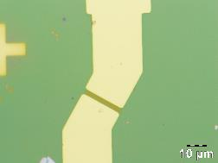
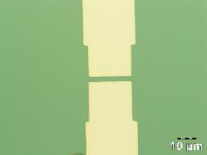
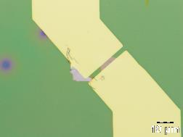
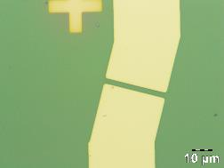
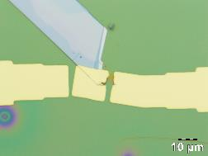
Thickness
Device 1 = 3.6±0.4 nm L= 3.3 W= 14.8
Device 2 = -
Device 3 = 9.2±0.8 nm L= 2.9 W= 8.6
Device 4 = -
Device 5 = -
Sample 11
Device 1
Device 2
Device 3
Device 4
Device 1
Device 5
Device 3
Device 4
Device 5
Device 2

Slide 19
Thickness
Device 1 = 3.6±0.4 nm L= 3.3 W= 14.8
Device 2 = -
Device 3 = 9.2±0.8 nm L= 2.9 W= 8.6
Device 4 = -
Device 5 = -
Sample 11
Device 1
Device 3
Device 1
Device 5
Device 3
Device 4
Device 2

Slide 20
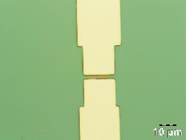
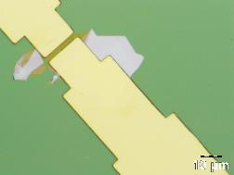
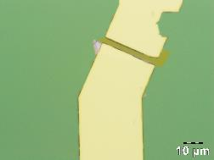
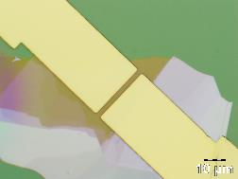
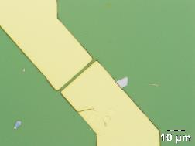
Thickness
Device 1 = 4.8±0.6 nm L= 2.9 W= 9.9
Device 2 = 2.4±0.3 nm L= 3.1 W= 13.2
Device 3 = 3.3±0.3 nm L= 3.8 W= 20.0
Device 4 = 4.8±0.3 nm L= 3.1 W= 18.5
Device 5 = -
Sample 12
Device 1
Device 2
Device 3
Device 4
Device 1
Device 2
Device 5
Device 3
Device 5
Device 4

Slide 21
Thickness
Device 1 = 4.8±0.6 nm L= 2.9 W= 9.9
Device 2 = 2.4±0.3 nm L= 3.1 W= 13.2
Device 3 = 3.3±0.3 nm L= 3.8 W= 20.0
Device 4 = 4.8±0.3 nm L= 3.1 W= 18.5
Device 5 = -
Sample 12
Device 1
Device 2
Device 3
Device 4
Device 1
Device 2
Device 5
Device 3
Device 4

Slide 22
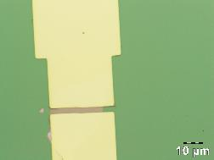
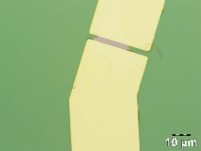
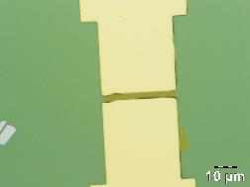
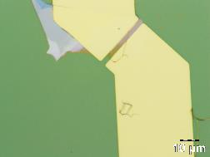
Thickness
Device 1 = 4.8±0.6 nm L= 3.5 W= 20.1
Device 2 = 2.4±0.3 nm L= 3.2 W= 15.5
Device 3 = 3.3±0.3 nm L= 3.7 W= 21.1
Device 4 = 4.8±0.3 nm L= 3.2 W= 16.4
Sample 14
Device 1
Device 2
Device 3
Device 4
Device 2
Device 1
Device 3
Device 4

Slide 23
Thickness
Device 1 = 4.8±0.6 nm L= 3.5 W= 20.1
Device 2 = 2.4±0.3 nm L= 3.2 W= 15.5
Device 3 = 3.3±0.3 nm L= 3.7 W= 21.1
Device 4 = 4.8±0.3 nm L= 3.2 W= 16.4
Sample 14
Device 1
Device 2
Device 3
Device 4
Device 2
Device 1
Device 3
Device 4

Slide 24
Blank devices
List:
Sample 6 Device 2
Sample 10 Device 4
Sample 11 Device 2
Sample 11 Device 4

